Slide 1
Endangered species
William Chokbengboune

Slide 2
Problem Statement
With urbanization of the Southeast United States, people are destroying the ecology of many species, some of which are unknown.

Slide 3
Source of information
US Fish and Wildlife Services
11015 rows of information
Data needed to be filtered to only a specific region

Slide 4
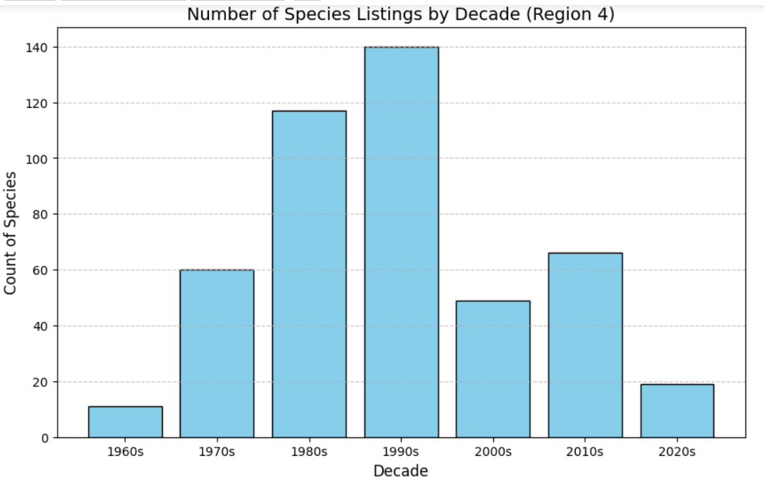
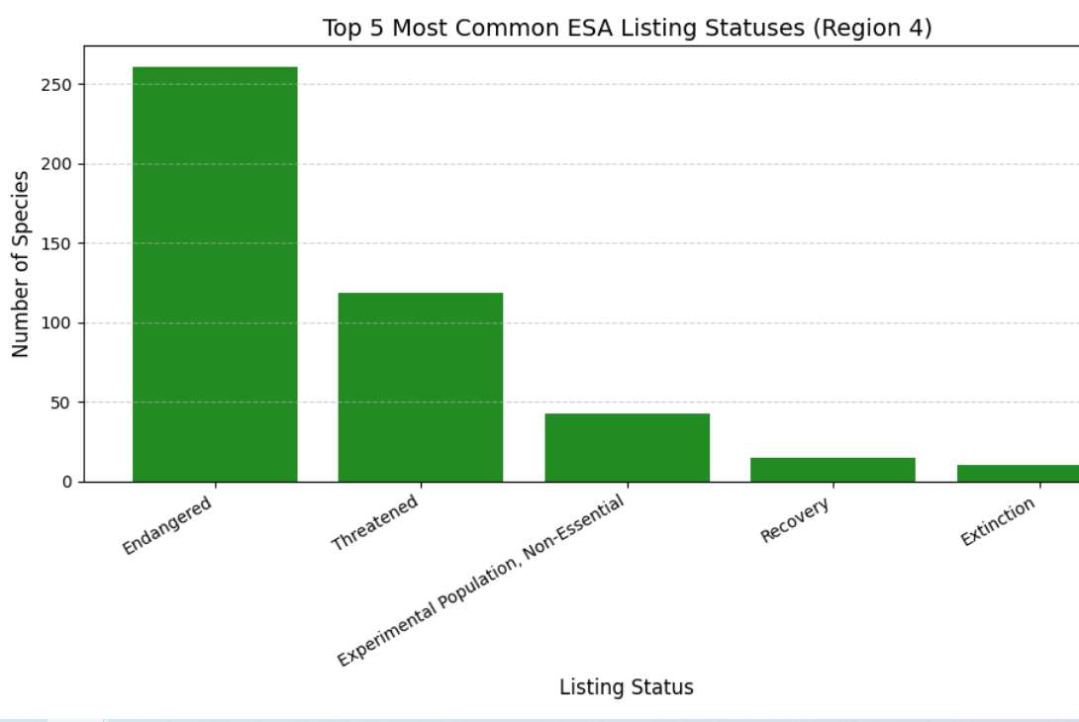
Data From Analysis

Slide 5
Conclusion
My initial hypothesis was incorrect.

